Slide 1
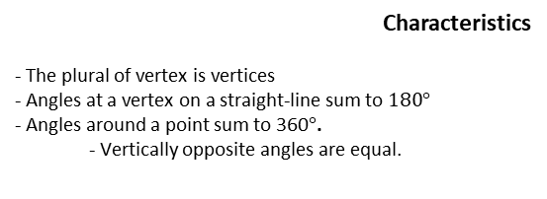
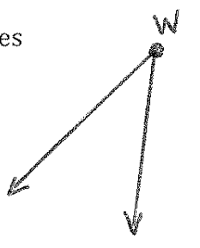
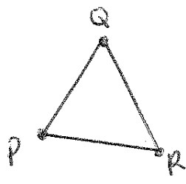
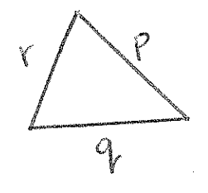
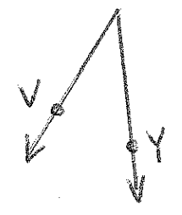

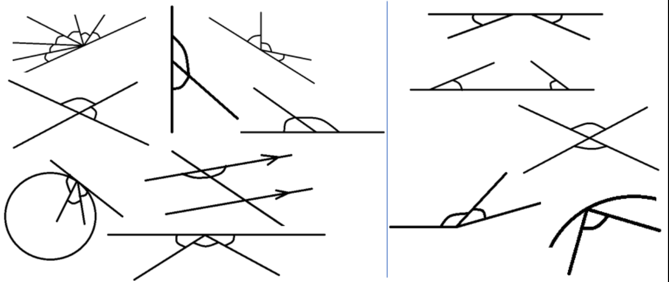


Subtopic G1.4 - Angles on a straight line, around a point, vertically opposite
LEARNING OUTCOME: To be able to solve simple angle problems
Objectives:
Keywords:
- Vertex
- Opposite
- Sum
To solve problems involving angles on a straight line
To solve problems involving angles around a point
To solve problems involving vertically opposite angles
Definition
The point at which two or more lines or sides meet.
Vertex
Non - Examples
Examples
Identifying angles at a vertex on a straight line
 | Example 1 – I do… | Example 2 – We do… | Example 3 – You do…
Steps | Do the following angles at a vertex form a straight line?
Find any angles at a vertex. Decide if they form a straight line.
No Yes No
Yes No Yes
Independent Practice
Question 1. Do the following angles at a vertex form a straight line?
a) b) c)
Yes No Yes

Slide 2
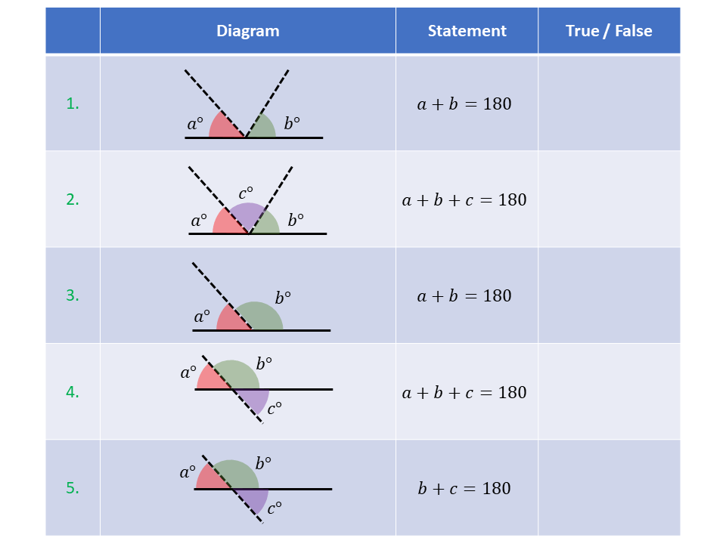
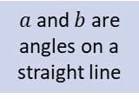
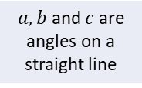
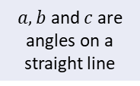
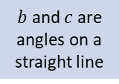
d) e) f)
g) h) i)
Yes No No
Yes Yes Yes
Question 2. Using the diagrams, decide if the statements are true or false.
False
True
True
False
True

Slide 3
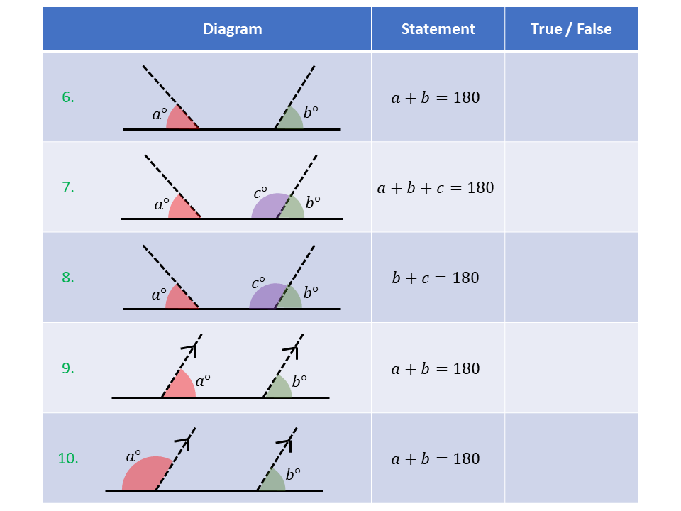

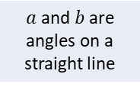
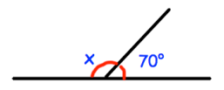
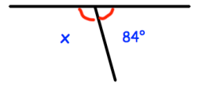
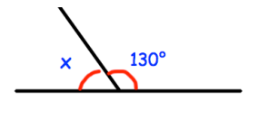
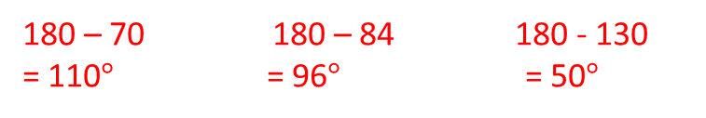
False
False
True
False
True
Angles at a vertex on a straight line
 | Example 4 – I do… | Example 5 – We do… | Example 6 – You do…
Steps | Find the missing angles.
Find the angles at a vertex on a straight line. Subtract from 180° to find the missing angle

Slide 4
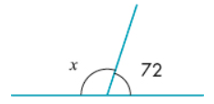
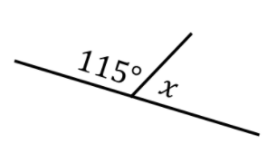
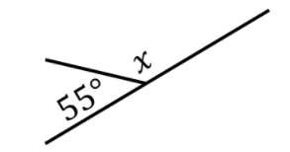





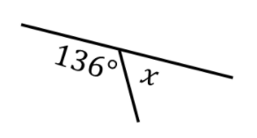
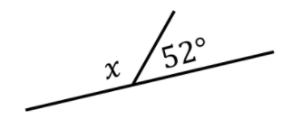





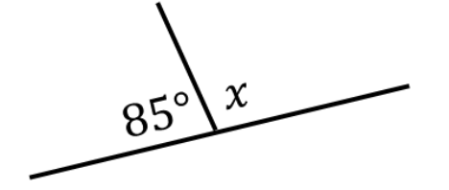
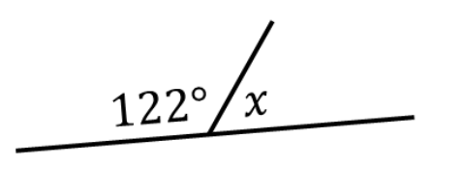




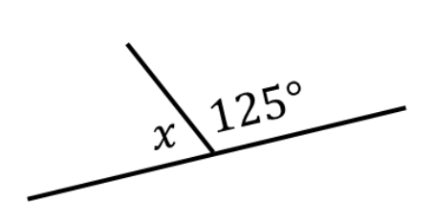
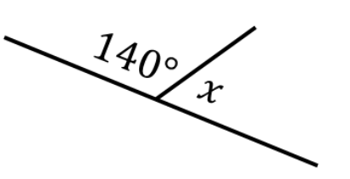



Independent Practice
Question 3. Find the missing angles
a) | b) | c)
d) | e) | f)
g) | h) | i)
j) | k) | l)

Slide 5
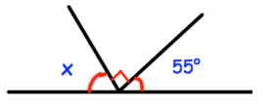
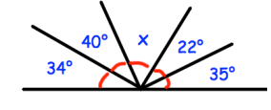
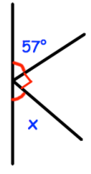
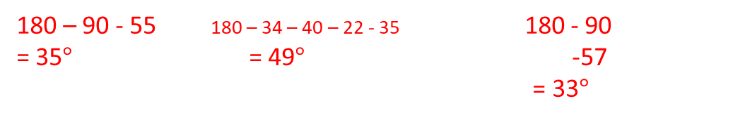
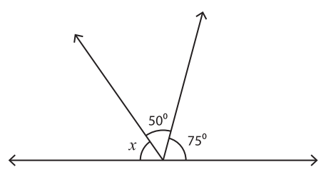
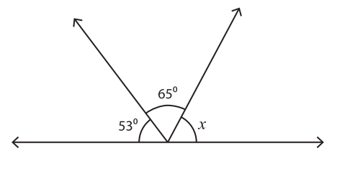
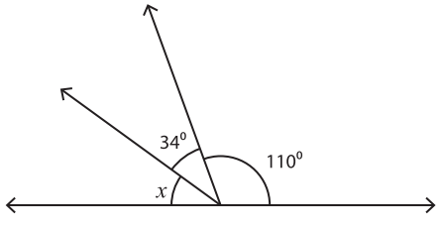



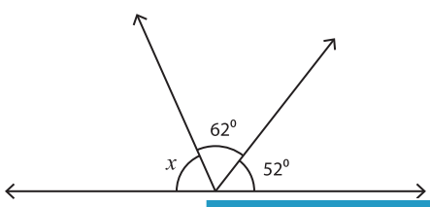
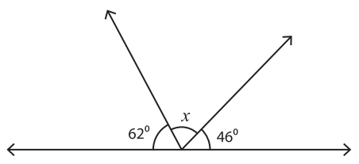
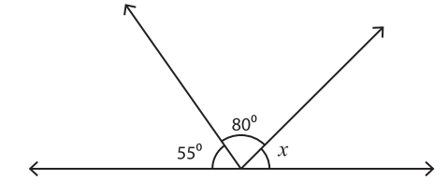



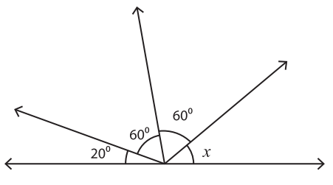
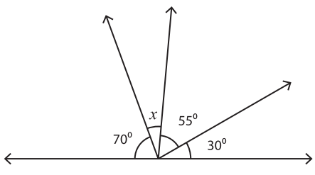
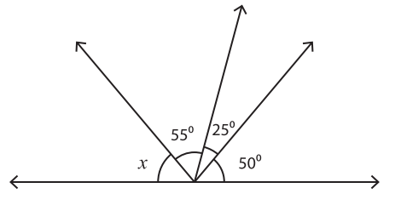



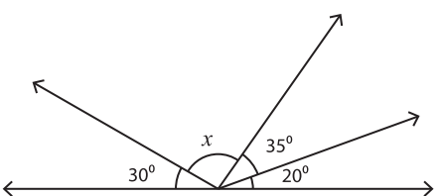
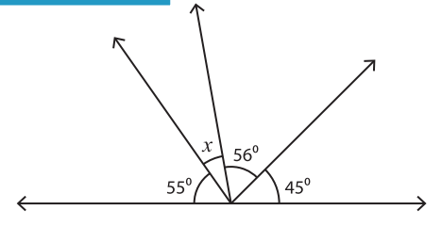
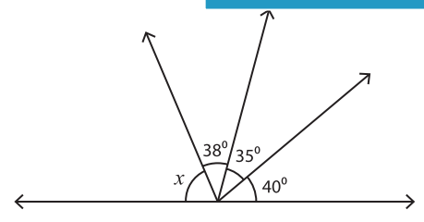



 | Example 7 – I do… | Example 8 – We do… | Example 9 – You do…
Steps | Find the missing angles.
Find the angles at a vertex on a straight line. Subtract from 180° to find the missing angle
Independent Practice
Question 4. Find the missing angles
a) | b) | c)
d) | e) | f)
g) | h) | i)
j) | k) | l)

Slide 6
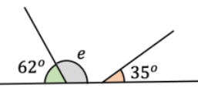
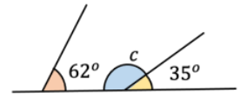
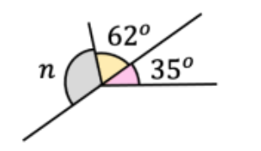



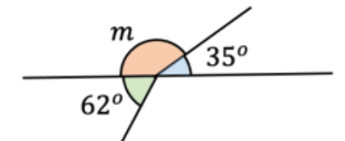
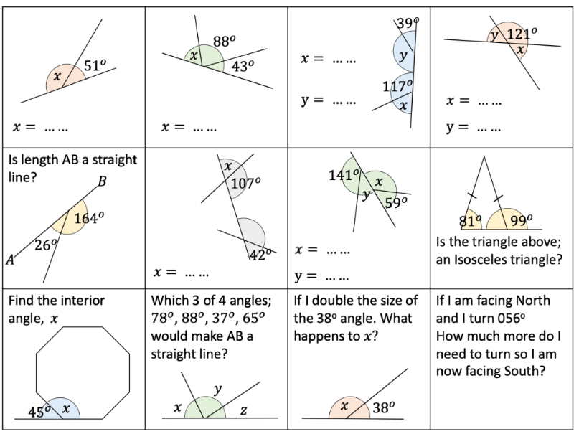
















Question 5. Find the missing angles
a) | b) | c)
d) | e) | f)
g) | h) | i)

Slide 7
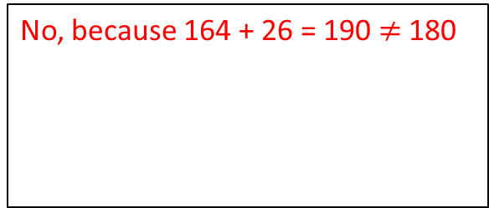
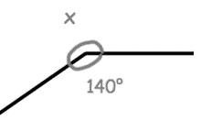
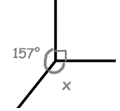










Question 6. Is AB a straight line? Give a reason for your answer.
Question 7. Which 3 of the following angles would form a straight line? 78°, 88°, 37° and 65°.
78, 37 and 65
Angles at a vertex around a point
Example 10 - I do…
Example 11 - We do…
Example 12 – You do…
Steps | Angles around a point - Calculate the missing angle
Find the angles at a vertex around a point. Subtract the sum of the existing angles from the total.
Independent Practice
Question 8. Calculate the missing angle
a) | b) | c)

Slide 8


























Question 8 continued
d) | e) | f)
g) | h) | i)
j) | k) | l)
m) | n) | o)

Slide 9








Question 9. Find the missing angles.
a)
b)
c)
Question 10. Three angles measure 97º, 145º and 118º. Do they fit exactly around a point? Give a reason for your answer.
Yes, because 97 + 145 + 118 = 360
Question 11. Five angles measure 78º, 95º, 113º, 162º and 187º. Which of them can be put together to fit exactly around a point?
95, 187 and 78
Question 12. Find the values of the missing angles.
Hint: Use angles on a straight line and angles around a point!

Slide 10
























Measuring a reflex angle
Example 13 - I do…
Example 14 - We do…
Example 15 – You do…
Steps | Measure the size of the reflex angle
Independent Practice
Question 13. Measure the reflex angles
a) | b)
c) | d)
e) | f)
g) | h)

Slide 11




















i) | j)
k) | l)
m) | n)
Drawing a reflex angle
Example 16 - I do…
Example 17 - We do…
Example 18 – You do…
Steps

Slide 12




















Question 14. Draw the reflex angle

Slide 13










Vertically opposite angles
Example 19 - I do…
Example 20 - We do…
Example 21 – You do…
Steps | Are the following angles vertically opposite?
Identify the vertex and the straight lines which go through this vertex Decide if the given angles are opposite each other at this vertex.
Yes
No
Yes
Independent Practice
Question 15. Are the following angles vertically opposite?
a) | b) | c)
d) | e) | f)
g) | h) | i)
Yes No No
Yes Yes No
Yes No Yes

Slide 14





Question 16. Mark on the vertically opposite angles.
a) | b) |  | c)
d) | e) |  | f)
g) | h) |  | i)
j) |  | k)
Question 17. Which angle is vertically opposite to…?
a? c
b? d
c? a
d? b
e? h
f? g
g? f
h? e

Slide 15




























Key fact: Vertically opposite angles are equal
Example 22 - I do…
Example 23 - We do…
Example 24 – You do…
Steps | Find the missing angle
Identify any vertically opposite angles. Label them as equal and solve the problem.
Independent Practice
Question 18. Calculate any missing angles
a) | b) | c)
d) | e) | f)
g) | h) | i)

Slide 16






























Example 25 - I do…
Example 26 - We do…
Example 27 – You do…
Steps | Calculate the missing angles.
Identify any vertically opposite angles Set these angles as equal Use the angle facts to find any other missing angles.
Independent Practice
Question 19. Calculate any missing angles
a) | b) | c)
d) | e) | f)
g) | h) | i)

Slide 17
















Mixed Practice
Question 20. Calculate any missing angles
a) | b) | c)
d) | e) | f)
g) | h) | i)

Slide 18












Question 21. Find the missing angles.
a)
b)
c)
Question 22. Find the size of x. Give reasons for your answer.
Question 23. Find the size of x, y and z. Give reasons for your answer.
Question 24. Find the size of x and y. Give reasons for your answer.

Slide 19




Skills Check
Find the missing angle.
a) 55º b) 125º
c) 305º d) 235º
Find the missing angle.
a) 80º b) 100º
c) 280º d) 260º
Find the missing angle.
a) 36º b) 144º
c) 324º d) 216º
Find the missing angles.
a = 104º, b = 104º
a = 76º, b = 76º
a = 76º, b = 104º
a = 104º, b = 76º

